Slide 1
Software Engineering
Lesson 2 – Agile Process Models
LO1 : Plan and tackle a small software design project as part of a team using an Agile approach.

Slide 2
Lesson Objectives
Understanding the features of different Agile Methodologies including:
Lean Programming
Extreme Programming (XP)
KanBan

Slide 3
Lean Programming

Slide 4

Lean Programming
What is Lean Programming?
“Lean programming is a concept that
emphasizes optimizing efficiency and
minimizing waste in the development of
a computer program.
The concept is that efficiencies can be applied and waste managed at all levels: each individual, every department, interdepartmental operations, the organization as a whole, and the relationships of the organization with customers and suppliers.”
Taken from : http://searchsoftwarequality.techtarget.com/definition/lean-programming

Slide 5

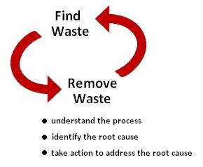
Lean Programming
What is Lean Programming all About?
Lean Programming is based on two fundamental elements:
Respect for people
Developing the capabilities of each person, learning continuously, and engaging individual talents and interests to serve the larger objectives—ultimately holding people accountable to the system, following it and improving it
Eliminating waste and variation
This requires intense focus on uncovering value as defined by you and delivering the value while eliminating activities that do not add value

Slide 6
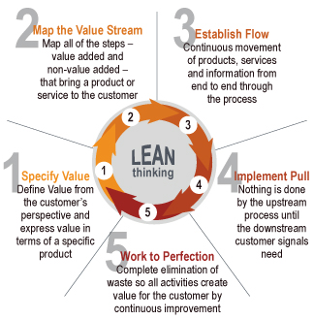
Lean Programming
How Should We Go About Lean Development?

Slide 7

Lean Programming
What are the Principles of Lean Programming?
Eliminate Waste
Build Quality in
Create Knowledge
Defer Commitment
Deliver Fast
Respect People
Optimize the whole

Slide 8
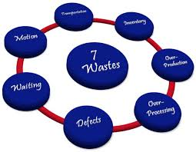
Lean Programming
What are the Principles of Lean Programming?
Eliminate Waste
With lean programming the aim is to focus only on what is really needed. Adding a lot of functions or process step that do not any benefits or which will not be used is a waste of time and resources and it will only divert effort from what is really important!

Slide 9
Lean Programming
What are the Principles of Lean Programming?
Eliminate Waste
Inventory such as incomplete , untested, undocumented code which is not deployable
Over – Production such as developing extra features which were not requested
Over – Processing by not making use of knowledge that is available within the team .
Defects such as bugs which create erroneous functionality that produces wrong output.
Waiting due to delays which may be caused by anything that causes more time to deliver a value-added activity
Motion due to team members moving from one task to another without completing the first task properly
Transport due to passing the work from person to another, after completing the first person's work -

Slide 10

Lean Programming
What are the Principles of Lean Programming?
Build Quality in
Ensure quality software through the use of built-in testing and extensive use of refactoring.
Create Knowledge
The development of a product should be a learning process for the whole team and the team should be allowed to share knowledge and their expertise to find the best ways of working for them.
Minimal rules should be imposed on the developers so that communication revolves around what the solution should feature, not on what the solution should be.
Customer should also be continuously involved in the development process so that feedback can be obtained as quickly as possible and acted upon.

Slide 11
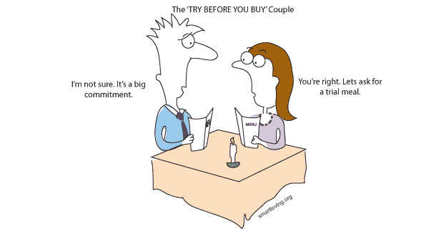
Lean Programming
What are the Principles of Lean Programming?
Defer Commitment
Decisions should be taken as late as
possible when more information is available.
It is useless to plan the requirements and design of a feature which is not a ‘must-have’ currently. Plans can be made further on in time and will be based on challenges encountered and solutions available at that point.

Slide 12

Lean Programming
What are the Principles of Lean Programming?
Deliver Fast
Allow a customer to see product features as soon as a working solution is available. This allows more opportunity for changes to be handled.
Working only on the most important features means no
energy is wasted on trivial and unnecessary detail. This
will result in solutions being available quicker.

Slide 13

Lean Programming
What are the Principles of Lean Programming?
Respect People
Empower the team. It is important to acknowledge the individuals’ characteristics and expertise and to motivate them in their role.
Optimize the whole
At all times it is important to keep a clear picture of the final solution that one is working towards. It is important to focus not only the individual feature releases but to give careful consideration to how these will integrate together.

Slide 14
Lean Programming
Advantages of using Lean Programming:
Eliminating waste increases the overall efficiency of the development process; this also speeds up the process of software development which reduces project time and cost.
Delivering product s early means that your development team can deliver more functionality in a shorter period of time, this enables more projects to be delivered.
Empowerment of the development team helps in developing the decision making ability of the team members and creates a more motivated team. In this way the team can determine how best to develop the functionality which usually results in a much better end product.

Slide 15
Lean Programming
Drawbacks of using Lean Programming:
The success project is highly dependent on the development team! How cohesive the team is, how disciplined the team members are and how exceptional their technical skills are.
The project sponsors and clients need to know what they want and make decisions they will stick to, otherwise indecision will delay the whole process!
The role of a business analyst is vital to ensure that requirements are understood properly; without proper skills it is easy to face problems such as scope creep.
Flexibility in Requirements Specification is great, but too much of it will quickly lead to a development which loses sight of it's original objectives.

Slide 16
Extreme Programming

Slide 17

Extreme Programming (XP)
What is Extreme Programming?
“Extreme Programming is a discipline of software development based on values of simplicity, communication, feedback, courage, and respect. It works by bringing the whole team together in the presence of simple practices, with enough feedback to enable the team to see where they are and to tune the practices to their unique situation”
Taken from : http://ronjeffries.com/xprog/what-is-extreme-programming/

Slide 18

Extreme Programming (XP)
Values of Extreme Programming :
Communication
Everyone is part of the team and communication is
mostly face to face and on a daily basis.
Team members are cross-functional and work together on everything from requirements to code.
The aim is to create the best solution to the problem can be found together.

Slide 19
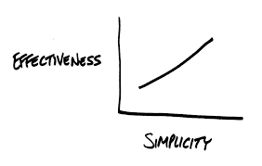
Extreme Programming (XP)
Values of Extreme Programming :
Simplicity
All that is needed and asked for is done, but no more.
This maximizes the value created for the investment made.
The team takes small simple steps to reach set out goals and mitigate failures as they happen.
The aim is to create something the team can take pride
in and maintain it long term for reasonable costs.

Slide 20

Extreme Programming (XP)
Values of Extreme Programming :
Feedback
Commitment in every single iteration is taken seriously
by delivering working software.
Software is demonstrated to the client early on and any changes needed are made based on feedback.
The team members and clients talk about the project and adapt process to it, not the other way around.

Slide 21

Extreme Programming (XP)
Values of Extreme Programming :
Respect
Everyone gives and feels the respect they deserve as a valued team member and contributes value even if it's simply enthusiasm.
Developers respect the expertise of the customers and vice versa.
Management respects team members’ right to
accept responsibility and receive authority over
our own work.

Slide 22

Extreme Programming (XP)
Values of Extreme Programming :
Courage
The truth about progress and estimates is always reported.
Excuses for failure are not documented because the team plans to succeed.
A strong feeling of team fellowship helps to adapt to changes when ever they happen as the team members do not feel that they are walking alone.

Slide 23
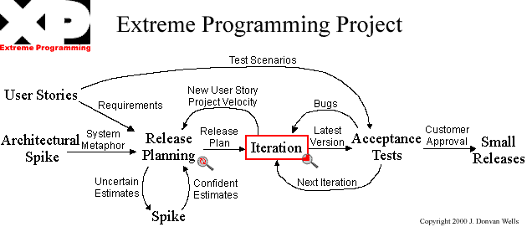
Extreme Programming (XP)
The structure of Extreme Programming:
XP encompasses a set of rules and practices that occur within the context of 4 framework activities: Planning, Design, Coding and Testing

Slide 24
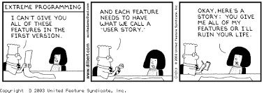
Extreme Programming (XP)
Characteristics of Extreme Programming
User requirements are broken down into a number of individual features called User Stories.
User Stories are assigned priorities so that the more important features are developed before others.
A team of people is assigned the development of a User Story. Multiple User Stories may be in development during the same time since teams will each work on their own feature in parallel.

Slide 25
Extreme Programming (XP)
Characteristics of Extreme Programming
Development of a user story is carried out in iterations. The team will plan, design, and implement during an iteration at the end of which the product can be demonstrated to the client. Changes needed are handled in the next iteration.
One person is assigned to be the Product Manager. His role is to continuously liaise with the client.
It is the responsibility of the team to decide roles and move towards feature completion. Regular meetings with Product Manager are crucial.

Slide 26
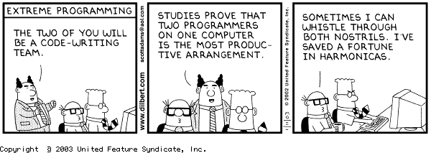
Extreme Programming (XP)
Characteristics of Extreme Programming
High code quality is a must. XP programming advocates test-driven development.
Pair programming is another technique used to ensure high code quality.

Slide 27
Extreme Programming (XP)
Advantages of using XP :
Allows the developers to concentrate on coding by avoiding unnecessary meetings and formalities.
Allows the team to quickly adapt to changing business environment with less cost. New requirements can be easily handled through the addition of a new user story which would be prioritized during the next team meeting.
A small release of tested software is available at the end of each iteration.
Focus on continuous testing ensures maintainable and high quality products.

Slide 28
Extreme Programming (XP)
Advantages of using XP :
Due to constant feedback with clients, flaws in the system are detected at an early stage and ensures expectations are met on project completion.
Pair programming reduces risks related to coding and also improves employee satisfaction. The dependency on a single person is reduced.
Since user requirements are broken down into user stories, each can be priced separately according to the amount of work required. This allows a user to select which features are ‘must-haves’ and ‘nice-to-haves’ is time or financial constraints are imposed

Slide 29
Extreme Programming (XP)
Drawbacks of using XP :
The framework needs customer involvement at all times.
Lack of proper documentation creates problems in big projects, especially when team members leave and new members join in.
XP is code centric and not design centric approach. Lack of design can be a problem for huge projects.
Too much refactoring can be a waste of time.
Due to lack of structure in XP, it might be difficult for testers to find defects.

Slide 30
Extreme Programming (XP)
Applications of XP :
When the system’s requirements are expected to change either because customers may not have a firm idea of what the system should do or because the system’s functionality is expected to change every few months.
When the system is considered as a high-risk project; such cases may include customers needing the system by a specific date or the system being a new challenge for your software group or the IT industry in general due to new technology
When the development team consists of a small group of programmers; between 2 and 12; larger teams will not be able to work effectively.
When client availability and commitment is given 100%. Asking questions, negotiating scope and schedules, and creating functional tests require more than just the developers be involved in producing the software.
When it is possible create automated unit and functional tests. .

Slide 31
Kanban

Slide 32
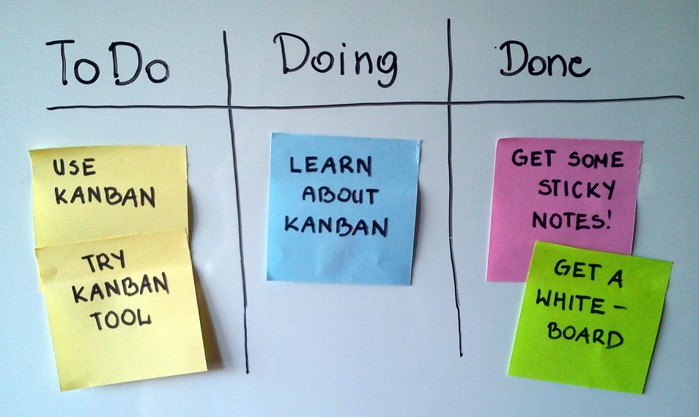
Kanban
What is Kanban?
“Kanban is a method for managing the
creation of products with an emphasis on
continual delivery while not overburdening
the development team”.
It is a popular framework, based on Toyota's "just-in-time" (JIT) production system, used in agile software development. It is enormously prominent among today's agile software teams; like Scrum, Kanban is a process designed to help teams work together more effectively.
Taken from : https://www.versionone.com/what-is-kanban/

Slide 33

Kanban
The Kanban Workflow
The work of all Kanban teams revolves around a Kanban board, a tool used to visualize work and optimize the flow of the work among the team.
This ensures that :
The team's work is visualized
The workflow is standardized
All blockers and dependencies are
immediately identified and resolved.

Slide 34
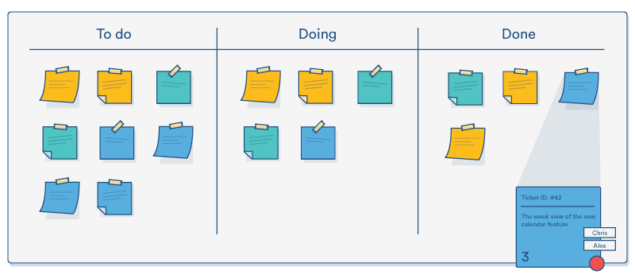
Kanban
The Kanban Workflow
A basic Kanban board has a three-step workflow:
To Do, In Progress, and Done.
Depending on a team's size, structure, and objectives, the workflow is mapped to meet the unique process of any particular team.

Slide 35
Kanban
The Kanban Workflow
Items on the Kanban Board are represented using a Kanban Card.
The main purpose is to allow team members to track the progress of work through its workflow in a highly visual manner.
Kanban cards feature critical information about that particular work item including :
who is responsible for that item of work
a brief description of the job being done
how long that piece of work is estimated to take
feature screenshots and other technical details (at times)
Allowing team members to see the state of every work item at any given point in time, as well as all of the associated details, ensures increased focus, full traceability, and fast identification of blockers and dependencies.

Slide 36
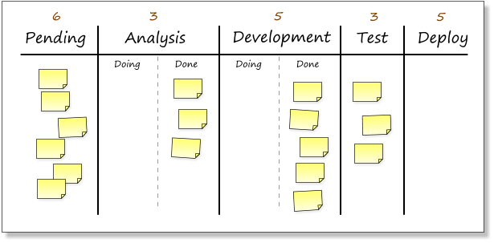
Kanban
The Kanban Workflow…An Example
This Kanban board shows a situation where the developers and analysts are being prevented from taking on any more work until the testers free up a slot and pull in the next work item.
At this point the developers and analysts should be looking at ways they can help relieve the burden on the testers.
Notes:
Some of the columns have been split in two, to indicate items being worked on and those finished and ready to be pulled by the down steam process.

Slide 37
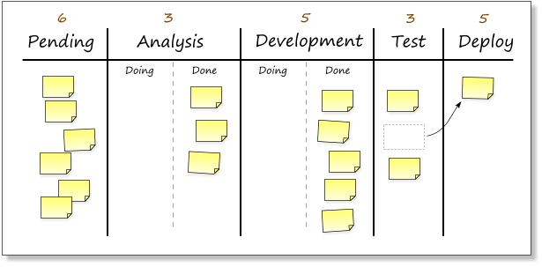
Kanban
The Kanban Workflow…An Example
Once the testers have finished testing a feature, they move the card and free up a slot in the "Test" column.

Slide 38
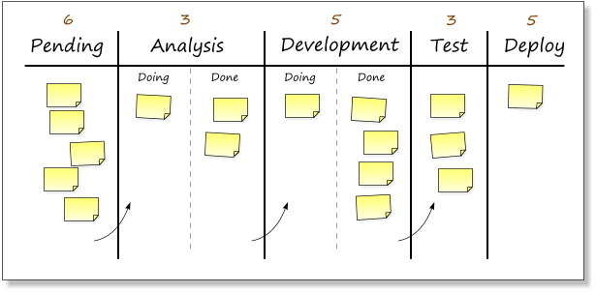
Kanban
The Kanban Workflow…An Example
One of the cards in the Development “Done” column” can now be shifted into the "Test" column.
This means that there is a free up a slot under "Development" and the next card can be pulled from the "Analysis" column and placed into development.

Slide 39
Kanban
Principles of Kanban
Visualize what you do today (workflow)
seeing all the items in context of each other can be very informative
Limit the amount of work in progress (WIP)
this helps balance the flow-based approach so teams dont start and commit to too much work at once
Enhance flow
when something is finished, the next highest thing from the backlog is pulled into play
Kanban promotes continuous collaboration and encourages active, ongoing learning and improving by defining the best possible team workflow.

Slide 40
Kanban
Why use Kanban?
Kanban enables software development teams today to leverage these same JIT principles by matching the amount of work in progress (WIP) to the team's capacity.
This gives teams more flexible planning options, faster output, clearer focus, and transparency throughout the development cycle.

Slide 41
Kanban
Kanban VS SCRUM
Similarities:
Both Kanban and Scrum focus on releasing software early and often. Both require highly-collaborative and self-managed teams.
There are, however, differences between the approaches!
Which method is best often depends on :
Organization,
Culture
Team Dynamics

Slide 42
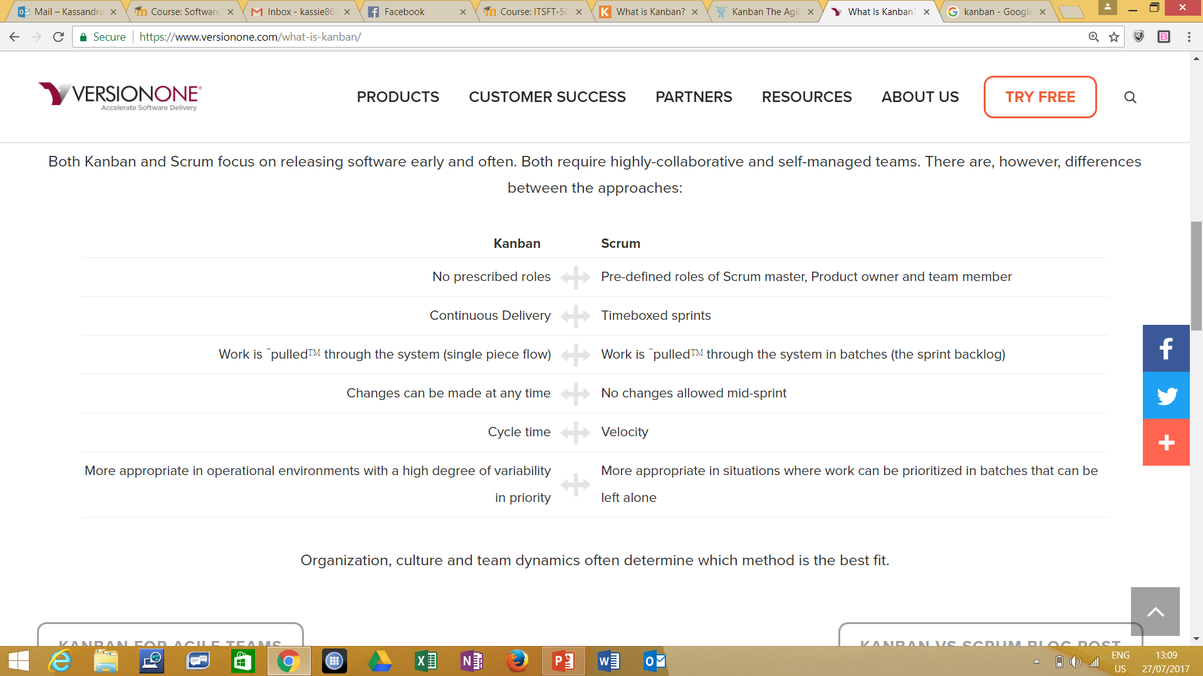
Kanban

Slide 43
End of Lesson 2
Any questions?

